Slide 1
Network Infrastructure Security
Information Security

Slide 2
Network Infrastructure Security
Securing a Network
Security through Network Design
  Subnetting
  Virtual LAN (VLAN)
  Demilitarized Zone (DMZ)
  Security through Network Technologies
  Network Address Translation (NAT)
  Virtual Private Networks (VPN)

Slide 3
Network Infrastructure Security
Applying Network Security Devices
  Firewalls
  Proxy Servers
  Honeypots
  Network Intrusion Detection Systems
  Host and Network Intrusion Prevention Systems
  Network Protocol Analyzers

Slide 4
Network Infrastructure Security
Securing a Network
Securing a network begins with the design of the network and includes secure network technologies

Slide 5
Network Infrastructure Security
Security through Network Design
Classful Addressing
  IP addresses are actually two addresses: one part is a network address and one part is a host address
  The split between the network and host portions of the IP address

Slide 6
Network Infrastructure Security
Security through Network Design: Subnetting
Subnetting
  To create multiple logical networks that exist within a single Class A, B, or C network
  Allows an IP address to be split anywhere
  Subnets are a subset of the entire network
    Networks can be divided into subnets
  Each subnet is treated as a separate network
    A subnet can be a WAN or LAN

Slide 7
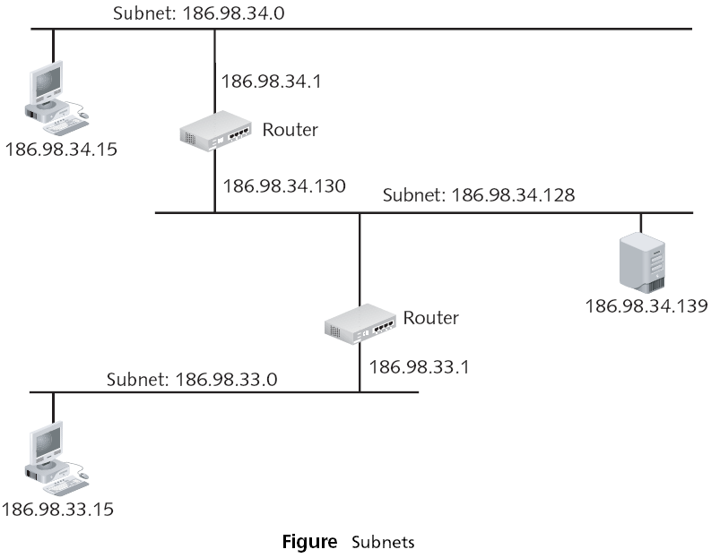
Network Infrastructure Security
Security through Network Design: Subnetting

Slide 8
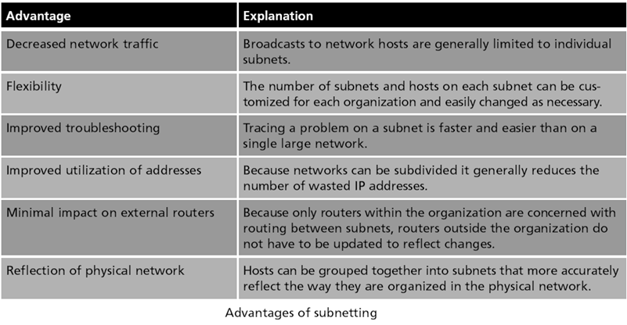
Network Infrastructure Security
Security through Network Design

Slide 9
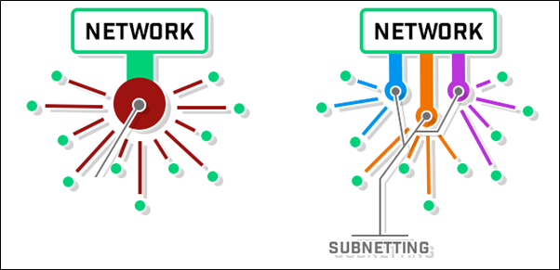
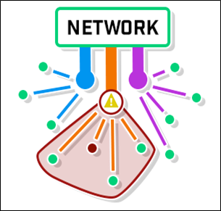
Security through Network Design (continued)
Security through Network Design: Subnetting
Isolating Security Threats

Slide 10
Security through Network Design (continued)
Security through Network Design: Subnetting
Security is enhanced by subnetting a single network
  Multiple smaller subnets isolates groups of hosts
Network administrators can utilize network security tools
Subnets also allow network administrators to hide the internal network layout

Slide 11
Security through Network Design (continued)
Security through Network Design: VLAN
Virtual LAN (VLAN)
  In most network environments, networks are divided or segmented by using switches
  A VLAN allows scattered users to be logically grouped together even though they may be attached to different switches
  Can reduce network traffic and provide a degree of security similar to subnetting:
    VLANs can be isolated so that sensitive data is transmitted only to members of the VLAN

Slide 12
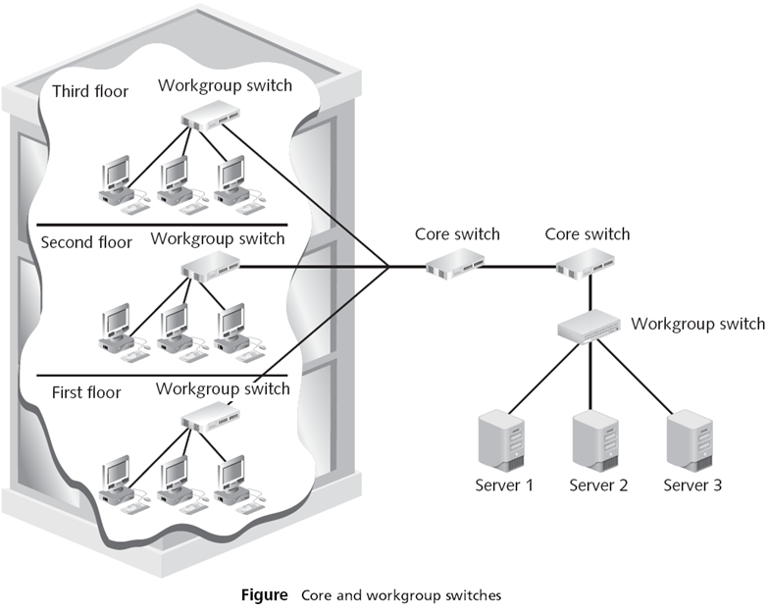
Network Infrastructure Security
Security through Network Design: VLAN

Slide 13
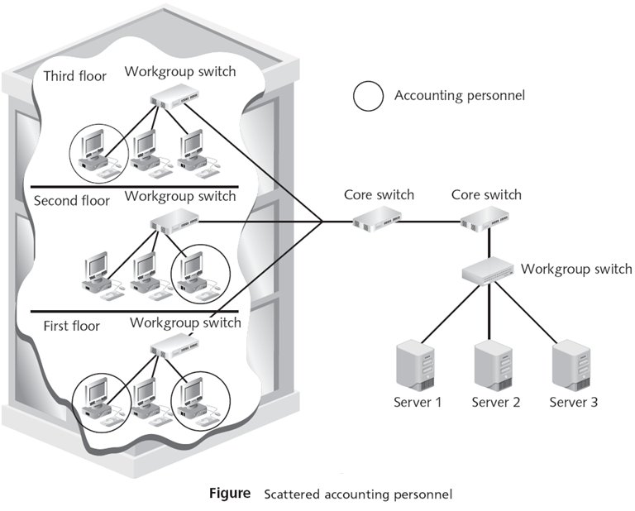
Network Infrastructure Security
Security through Network Design: VLAN

Slide 14
Network Infrastructure Security
Security through Network Design: VLAN
VLAN communication can take place in two ways
  All devices are connected to the same switch
    Traffic is handled by the switch itself
  Devices are connected to different switches
A VLAN is heavily dependent upon the switch for correctly directing packets

Slide 15
Network Infrastructure Security
Security through Network Design: DMZ
Demilitarized Zone (DMZ)
  A DMZ is a perimeter network that enables organizations to protect their internal networks.
  It enables organizations to provide access to untrusted networks, such as the internet, while keeping private networks or local-area networks (LANs) secure.
  Outside users can access the DMZ but cannot enter the secure network
  Resources commonly placed in the DMZ include, Web servers, Mail servers, FTP servers, and VoIP servers.

Slide 16
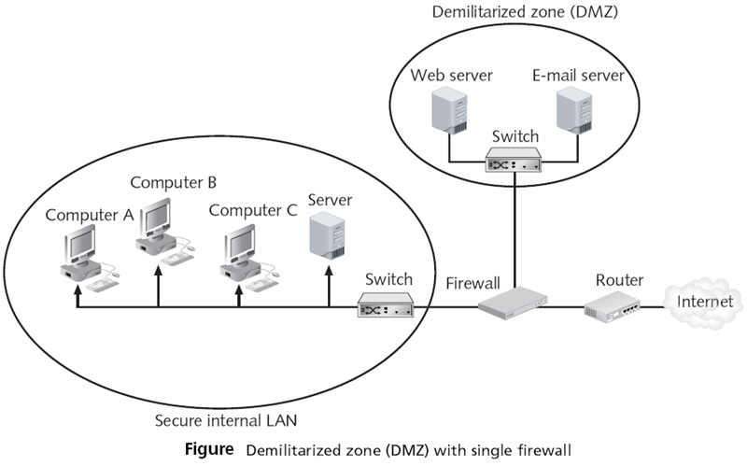
Network Infrastructure Security
Security through Network Design: DMZ

Slide 17
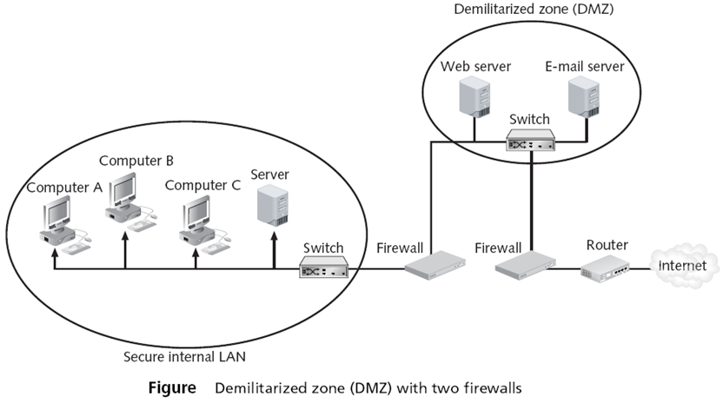
Network Infrastructure Security
Security through Network Design: DMZ

